Slide 1
Introducing the Sprint 2 use case:
Mule United Airport
Presented by:
Rajat Kumar Nayak

Slide 2
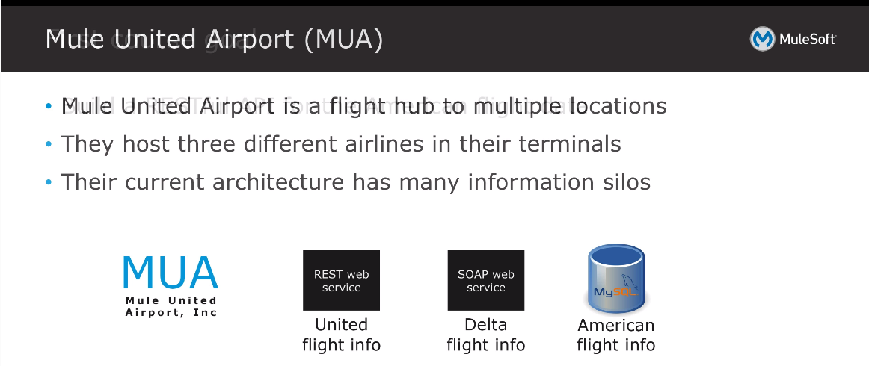

Slide 3
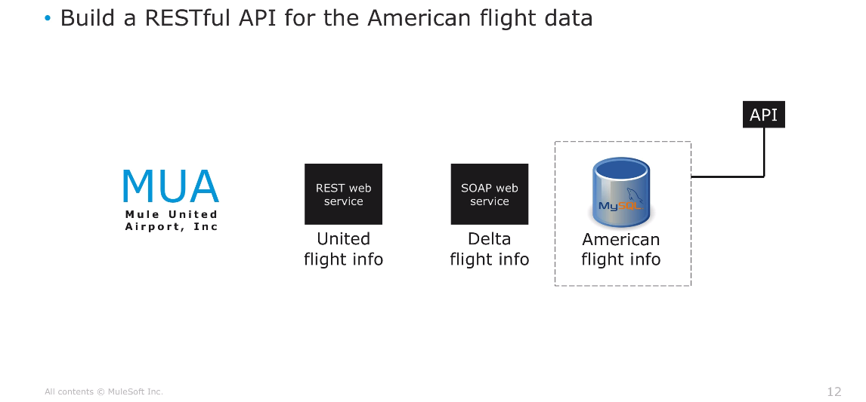
American Airlines RESTful API

Slide 4
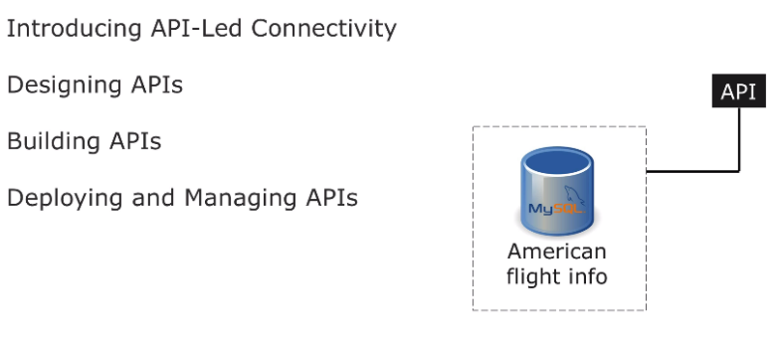
Designing new API Specification for American Airlines

Slide 5
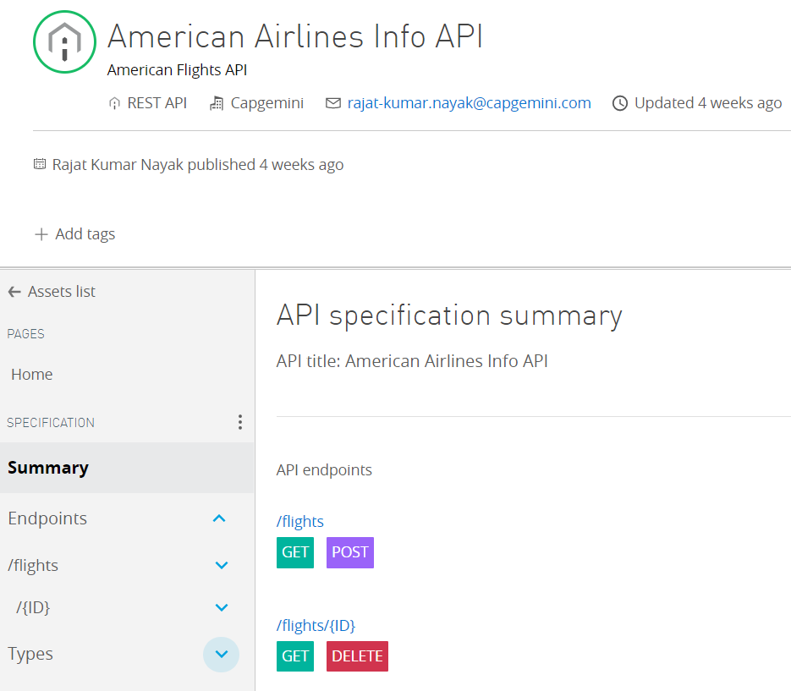
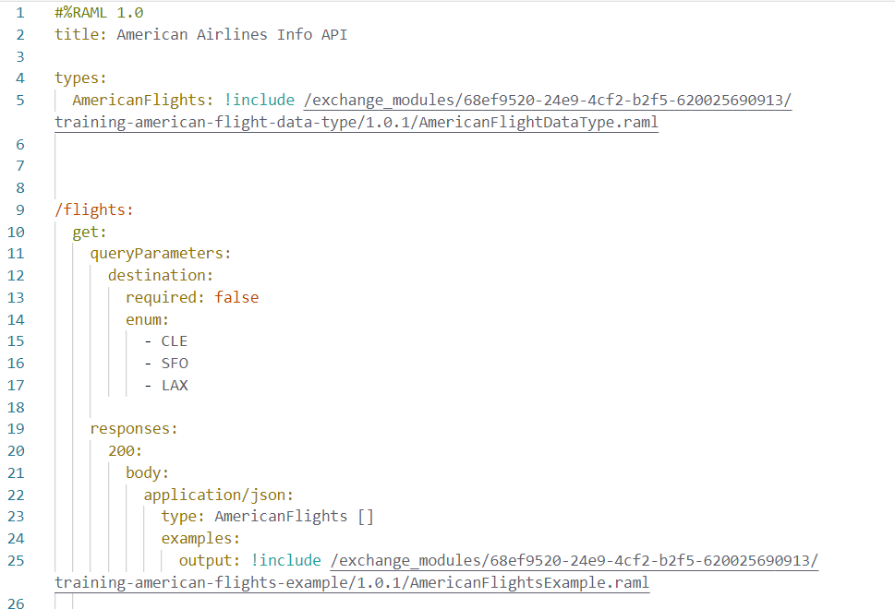
Creating a new API specification using RAML 1.0

Slide 6
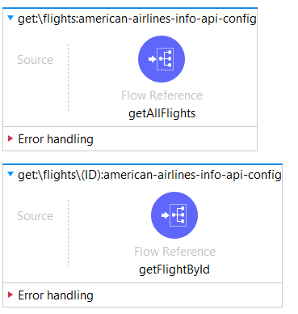
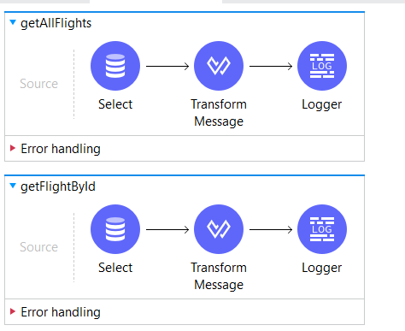
Building API for American Airlines

Slide 7
Deploying the API
The American Airlines RESTful API is deployed in Runtime Manager with the following URL:
URL: http://rajat-american-airlines-api.us-e2.cloudhub.io/api/flights

Slide 8
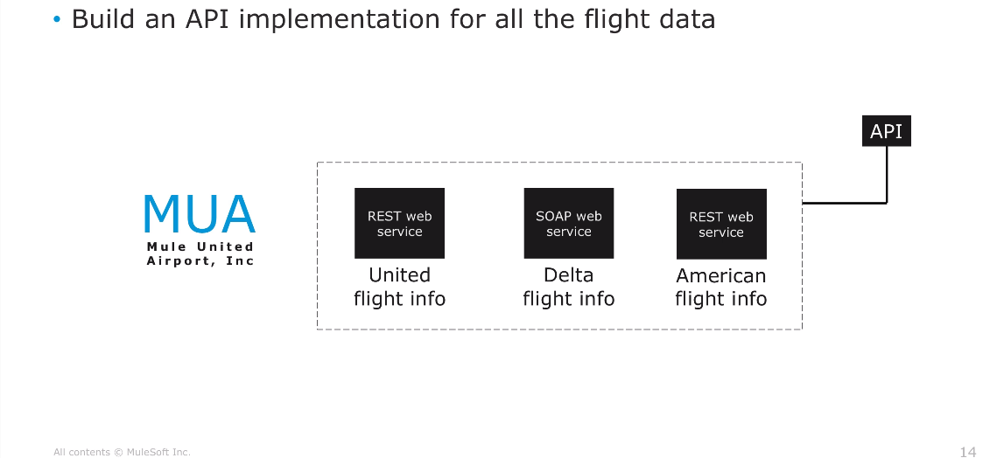
Creating MUA Airlines API

Slide 9
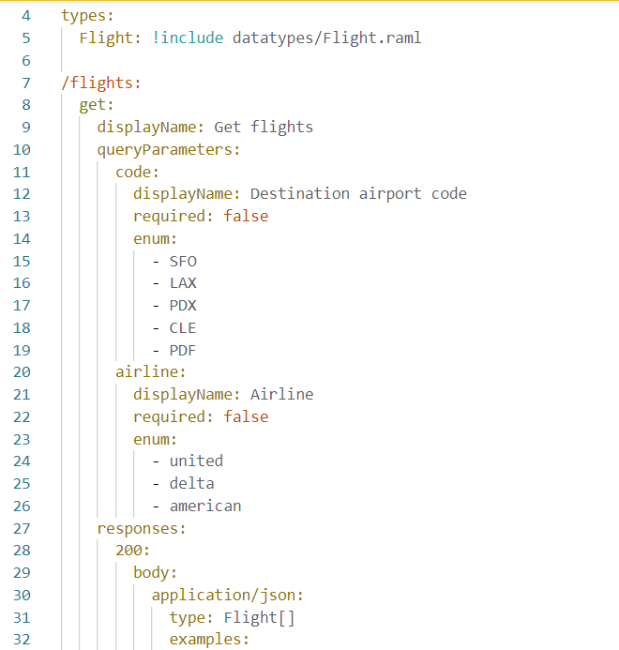
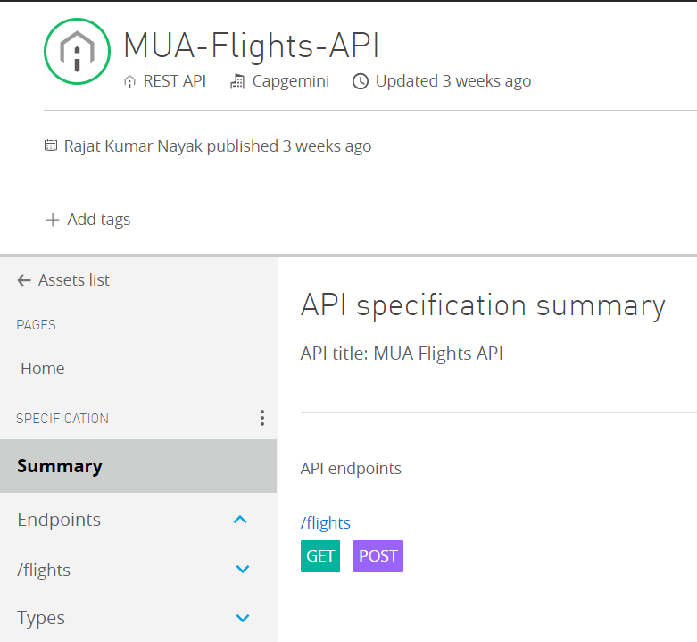
Creating a new API specification for MUA Flights using RAML 1.0

Slide 10
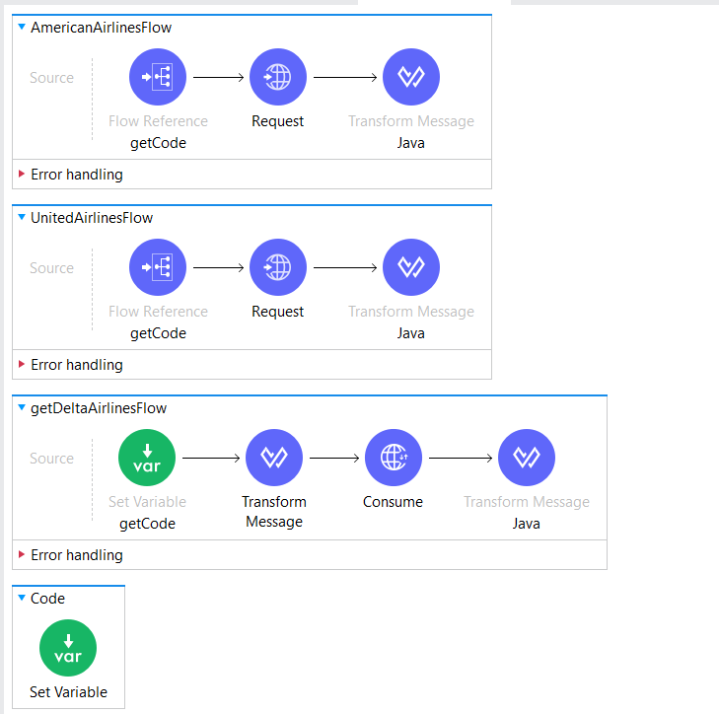
Creating three flows for the airlines

Slide 11
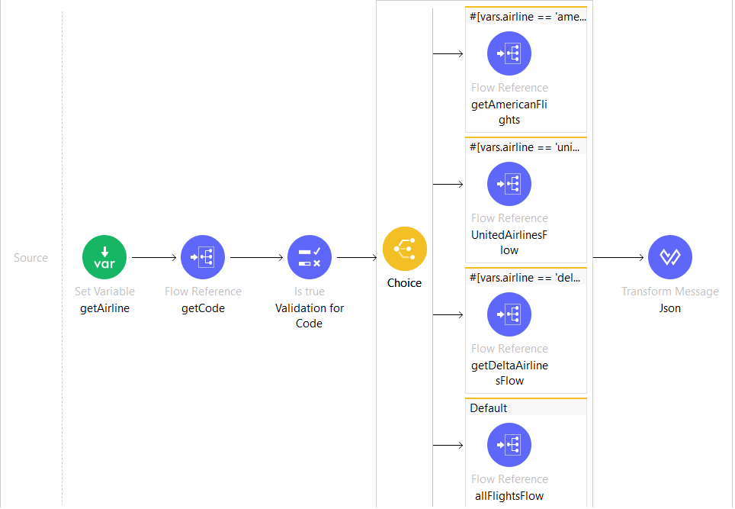
Using Choice Router

Slide 12
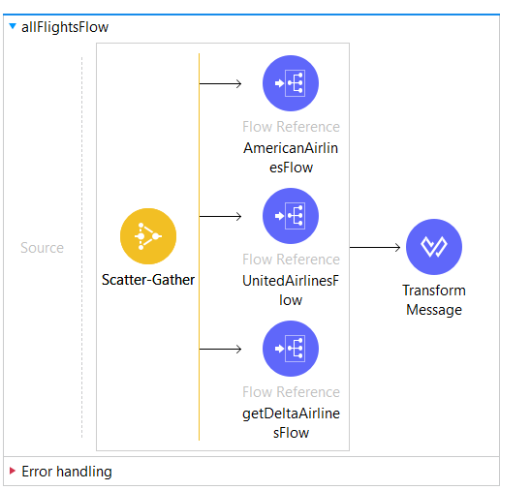
Using Scatter-Gather

Slide 13
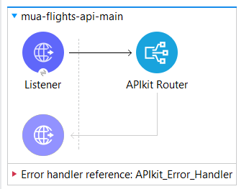
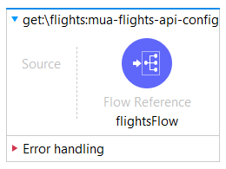
Using APIkit Router

Slide 14
Deploying the API
The API is deployed in Runtime Manager with the following credentials:
URL: http://rajat-mua-flights-api.us-e2.cloudhub.io/api/flights
client_id: a968285592ab4d27bdde81f6ac7a06a5
client_secret: 77Aa7f42EE11467e82f94a937F4aF019

Slide 15
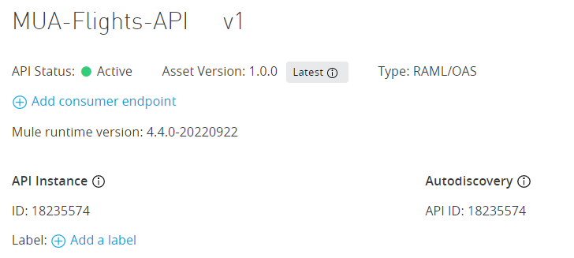
Managing the API using Autodiscovery

Slide 16
Thank You

